Slide 1
Lecture 3
CT-524
Knowledge Based System

Slide 2
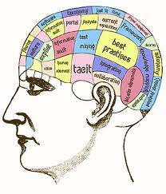
Knowledge ?

Slide 3
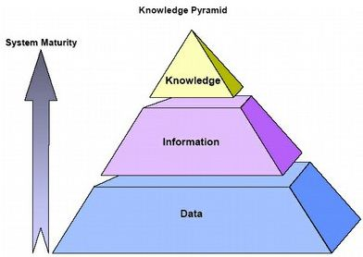
Review
Data
Coarse
Information
Organized data
Knowledge
Practical information used to solve the problems

Slide 4
Types of knowledge
Declarative knowledge
Knowledge or facts about objects and concepts.
e.g. A day consists of 24 hours
Procedural Knowledge
Describes how a problem is solved.
e.g. To find the mean of three figures, add them and divide by three

Slide 5
Types of knowledge (continue)
Heuristic knowledge
Depends on our experience, judgments,
tricks etc. (common senses)
Meta Knowledge
Knowledge about knowledge

Slide 6
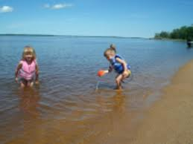

Level of Knowledge
Shallow Knowledge
Surface level knowledge use solve low-level problem can be expressed by IF THEN rule.
Deep Knowledge
Knowledge for solving complex problem. Like doctor diagnose disease of patient.

Slide 7
Knowledge Acquisition
Knowledge acquisition includes the elicitation, collection, analysis, modeling and validation.

Slide 8
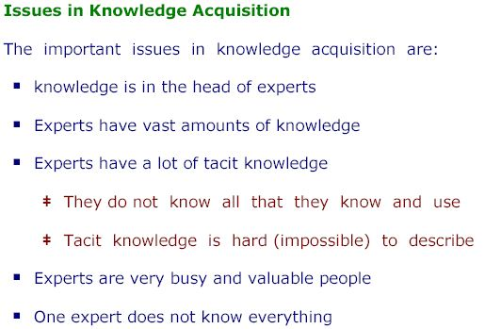

Slide 9
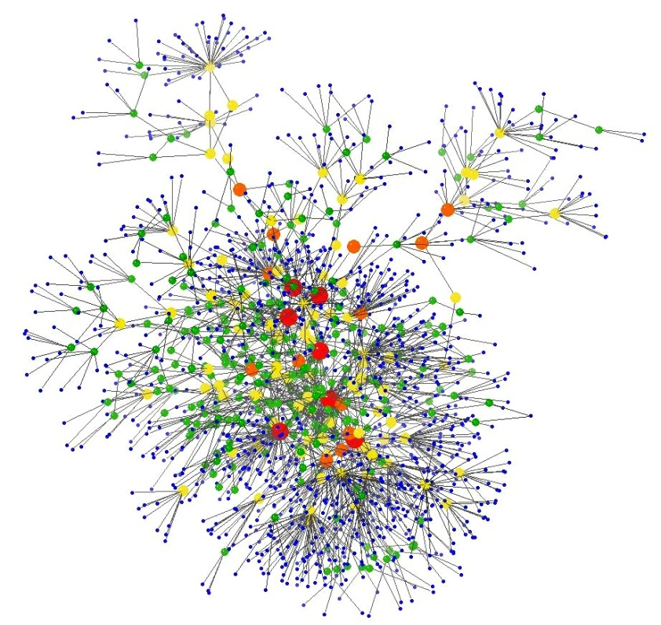
Knowledge Representation

Slide 10
Issues in Knowledge Representation
Some issues that arise in knowledge representation from an AI perspective are:
How do people represent knowledge?
What is the nature of knowledge?
Should a representation scheme deal with a particular domain or should it be general purpose?
How expressive is a representation scheme or formal language ?
Should the scheme be declarative or procedural?

Slide 11
Knowledge Representation
The knowledge of an expert system can be represented in a number of ways includes:
Semantic networks
Scripts
Frames
Conceptual graph

Slide 12
Semantic networks
A method of knowledge representation using a graph made up of nodes and arcs, where nodes usually represent objects, and arcs the relationships between objects”

Slide 13
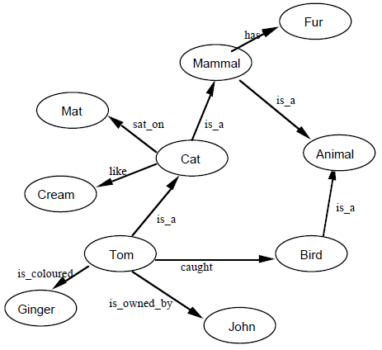
Semantic Nets

Slide 14
is intended to represent the data:
Tom is a cat.
Tom caught a bird.
Tom is owned by John.
Tom is ginger in color.
Cats like cream.
The cat sat on the mat.
A cat is a mammal.
A bird is an animal.
All mammals are animals.
Mammals have fur.

Slide 15
Issues with semantic nets
A particular problem is that we haven’t distinguished between nodes representing classes of things, and nodes representing individual objects.
So, for example, the node labelled Cat represents both the single (nameless) cat who sat on the mat, and the whole class of cats to which Tom belongs, which are mammals and which like cream.

Slide 16
Solution
We can clean up the representation by distinguishing between nodes representing individual or instances, and nodes representing classes.
Link is_a only be used to show an individual.
Link a_kind_of or ako representing one class may be used in the place of is_a.

Slide 17
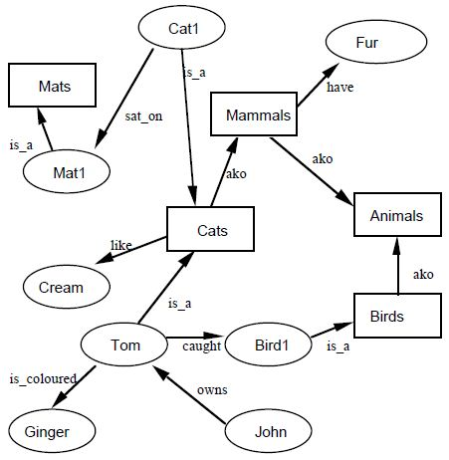
The revised semantic net is:

Slide 18
A direct Prolog representation
cat(tom).
cat(cat1).
mat(mat1).
sat_on(cat1,mat1).
bird(bird1).
caught(tom,bird1).
like(X,cream) :– cat(X).
mammal(X) :– cat(X).
has(X,fur) :– mammal(X).
animal(X) :– mammal(X).
animal(X) :– bird(X).
owns(john,tom).
is_coloured(tom,ginger).

Slide 19
Scripts
A Scripts is a structured representation describing a stereotyped (clear and dual)sequence of events/actions in a particular context.
The term ‘scripts’ coined by Schank and Abelson in 1977.

Slide 20
Scripts (continue)
The classic example of a script involves the typical sequence of events that occur when a person dines in a restaurant: finding a seat, reading the menu, ordering drinks from the waiters staff...

Slide 21
components of Scripts
The components of Scripts are:
Entry Conditions: Customer, cashier
Results: Having meal, paid bill
Props: plates, cutlery, Table, chair, reception desk etc.
Roles: waiter takes orders
Scenes: ordering meal, eating meal etc.

Slide 22
Humn……….☺
Write an script for dine in a restaurant
(Class work)
Write an script for shopping in a Wal-Mart
Write an script for based on your own/ personnel experience

